Slide 1
Data Structure and Algorithms
Lecture 11
Graphs

Slide 2
What is a Graph?
A graph consists of a number of data items, each of which is called a vertex. Any vertex may be connected to any other, these connections are called edges.
A graph G = (V,E) is composed of:
V: set of vertices
E: set of edges connecting the vertices in V
An edge e = (u,v) is a pair of vertices
Example:
a
b
V= {a,b,c,d,e}
E= {(a,b),(a,c),(a,d),
(b,e),(c,d),(c,e),
(d,e)}
c
d
e

Slide 3
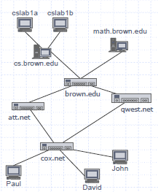
Applications
Electronic circuits
  Printed circuit board
  Integrated circuit
Transportation networks
  Highway network
  Flight network
Computer networks
  Local area network
  Wide area network
  Internet
Databases
  Entity-relationship diagram

Slide 4
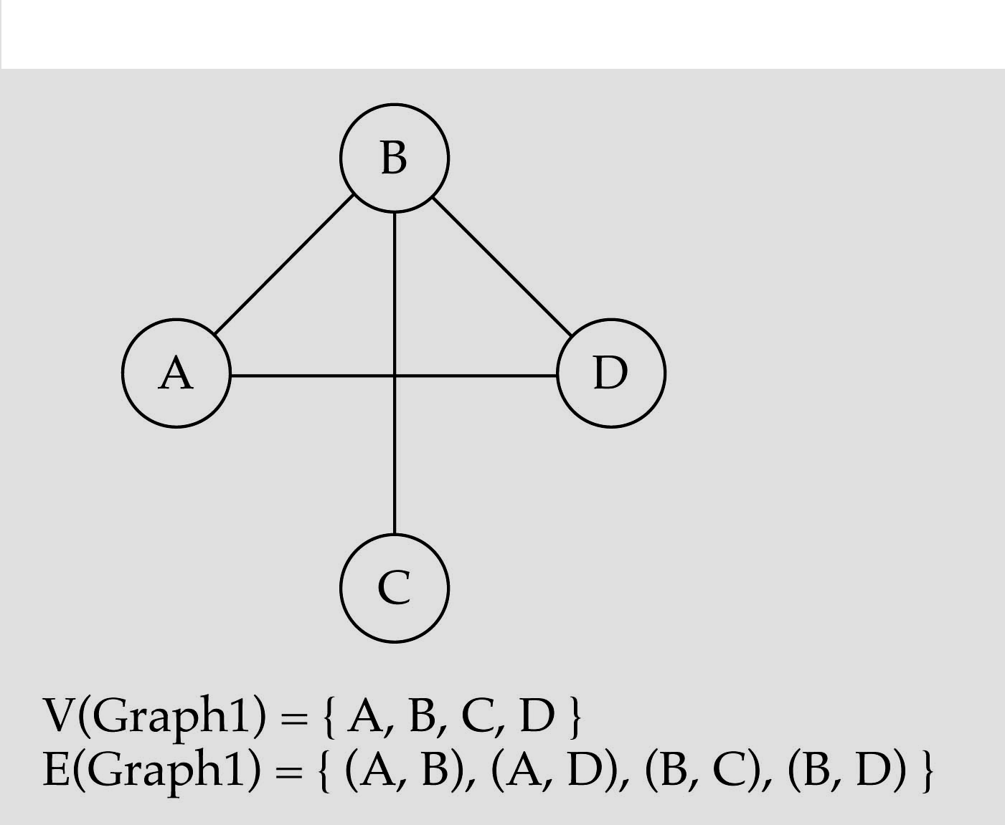
Directed and Undirected Graph
Undirected graph
  When the edges in a graph have no direction, the graph is called undirected

Slide 5
Directed and Undirected Graph
When the edges in a graph have a direction, the graph is called directed graph .
Also known as digraph.
This kind of graph contains ordered pair of vertices i.e. if the graph is directed, the order of the vertices in each edge is important.
V = {A, B, C, D, E}
E = {(A,B), (B,C), (C,B), (A,C), (A,E), (C,D)}
A
B
E
C
D

Slide 6
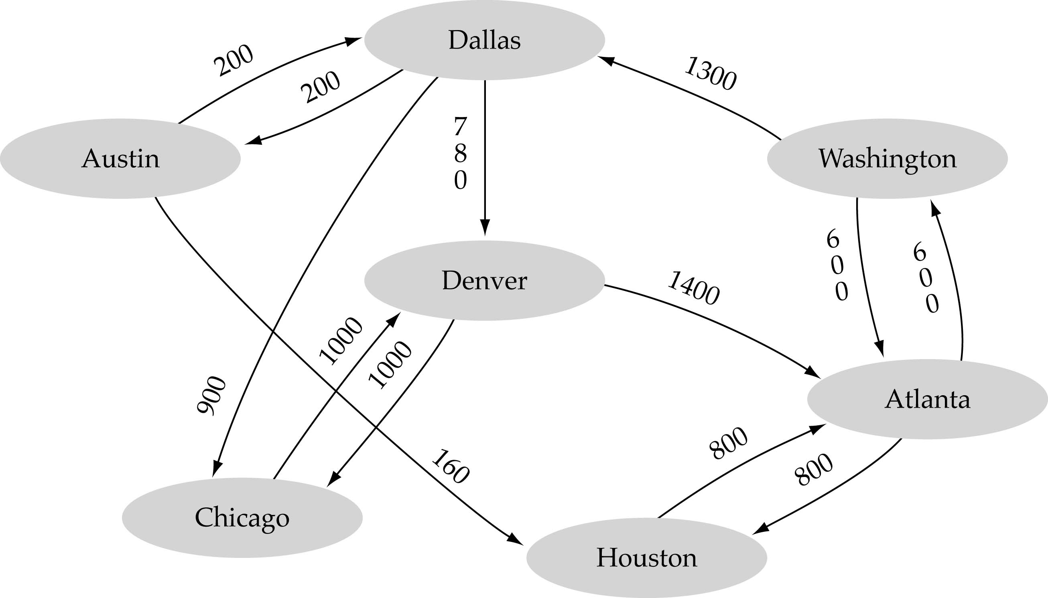
Graph Terminologies
Weighted Graph
  A graph is suppose to be weighted if its every edge is assigned some value which is greater than or equal to zero.

Slide 7
Graph Terminologies
Adjacent Nodes
  When there is an edge from one node to another then these nodes are called adjacent nodes.
Path
  sequence of vertices v₁,v₂,. . .v_{k} such that consecutive vertices v_{i} and v_{i+1} are adjacent.
a
b
a
b
c
c
d
e
d
e
a b e d c
b e d c

Slide 8
Graph Terminologies
Length of a Path
  Length of a path is nothing but the total number of edges included in the path from source to destination node.
Simple Path
  path such that all its vertices and edges are distinct.
a
b
b e c
c
d
e

Slide 9
Graph Terminologies
Cycle
  simple path, except that the last vertex is the same as the first vertex
Acyclic Graph
  A graph without cycle is
  called acyclic Graph. A tree
  is a good example of acyclic
  graph.
a
b
c
d
e
a b e c a

Slide 10
Graph Terminologies
Connected Graph
  An undirected graph is connected if, for any pair of vertices, there is a path between them.
  A directed graph is connected if, for any pair of vertices, there is a path between them.
Connected
Not Connected

Slide 11
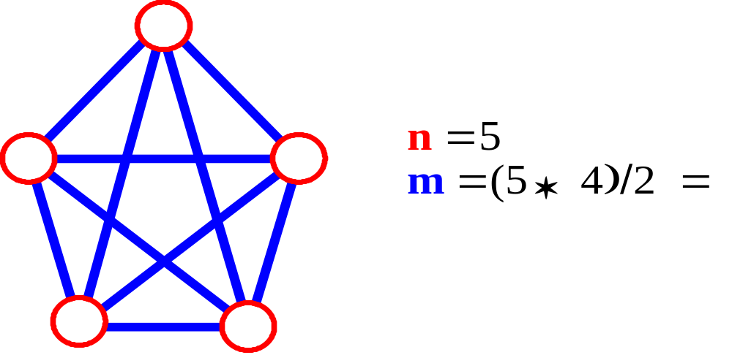
Graph Terminologies
Complete Graph
  A graph in which all pairs of vertices are adjacent OR
  A graph in which every vertex is directly connected to every other vertex
  Let n = Number of vertices, and
  m = Number of edges
  For a complete graph with n vertices, the number of edges is n(n – 1)/2. A graph with 6 vertices needs 15 edges to be complete.

Slide 12
Graph Terminologies
Degree of a node
  In an Undirected graph, the total number of edges linked to a node is called a degree of that node.
  For directed graph there are two degree for every node
    Indegree
      The indegree of a node is the total number of edges coming to that node.
    Outdegree
      The outdegree of a node is the total number of edges going out from that node

Slide 13
Graph Terminologies
3
0
0
2
1
2
3
1
2
3
3
3
3
4
5
6
G
3
3
1
1
1
1
0
in:1, out: 1
G2
Directed graph
in-degree
out-degree
1
in: 1, out: 2
2
in: 1, out: 0
G3

Slide 14
Graph Representation
There are two methods to represent a Graph
  Adjacency Metrix ( Array Implementation)
  Adjacency List (Linked List Implementation)

Slide 15
Adjacency Matrix
Let G=(V,E) be a graph with n vertices.
The adjacency matrix of G is a two-dimensional
n by n array, say adj_mat
If the edge (vi, vj) is in E(G), adj_mat[i][j]=1
If there is no such edge in E(G), adj_mat[i][j]=0
The adjacency matrix for an undirected graph is symmetric; since adj_mat[i][j]=adj_mat[j][i]
The adjacency matrix for a digraph may not be symmetric

Slide 16
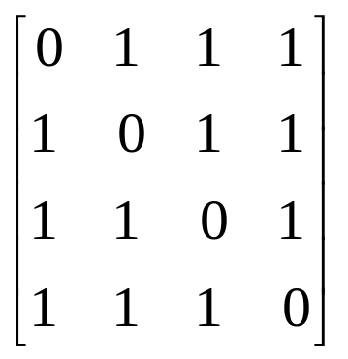
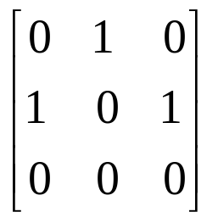
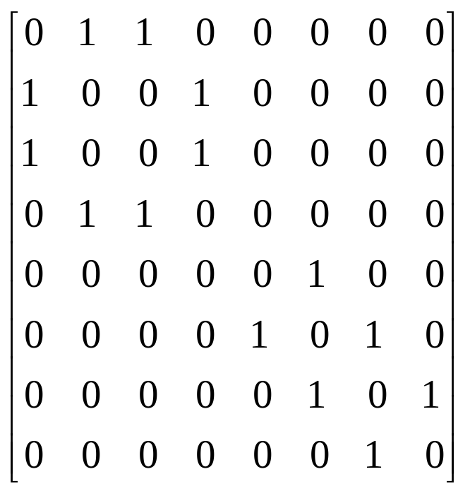
Examples for Adjacency Matrix
0
0
4
0
1
2
2
1
5
3
3
6
1
7
2
G2
G1
symmetric
G4

Slide 17
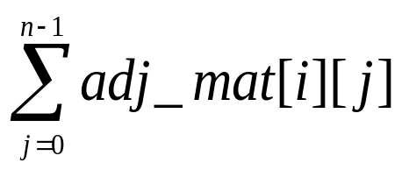
Adjacency Matrix
From the adjacency matrix, to determine the connection of vertices is easy
The degree of a vertex is
We can also represent weighted graph with Adjacency Matrix. Now the contents of the martix will not be 0 and 1 but the value is substituted with the corresponding weight.

Slide 18
Another Example
Adjacency Matrix?
1
2
4
5
3
6
7

Slide 19
 | 1 | 2 | 3 | 4 | 5 | 6 | 7
1 | 0 | 1 | 1 | 1 | 0 | 0 | 0
2 | 0 | 0 | 0 | 1 | 1 | 0 | 0
3 | 0 | 0 | 0 | 0 | 0 | 1 | 0
4 | 0 | 0 | 1 | 0 | 0 | 1 | 1
5 | 0 | 0 | 0 | 1 | 0 | 0 | 1
6 | 0 | 0 | 0 | 0 | 0 | 0 | 0
7 | 0 | 0 | 0 | 0 | 0 | 1 | 0

Slide 20
Adjacency List
A Single Dimension array of Structure is used to represent the vertices
A Linked list is used for each vertex V which contains the vertices which are adjacent from V (adjacency list)

Slide 21
0
0
4
2
1
5
1
2
3
6
3
7
0
1
2
3
1
2
3
0
1
2
3
4
5
6
7
1
2
0
2
3
0
3
0
1
3
0
3
0
1
2
1
2
G1
0
5
4
6
0
1
2
1
5
7
0
2
1
6
G3
G4
2

Slide 22
Another Example of Adjacency List

Slide 23
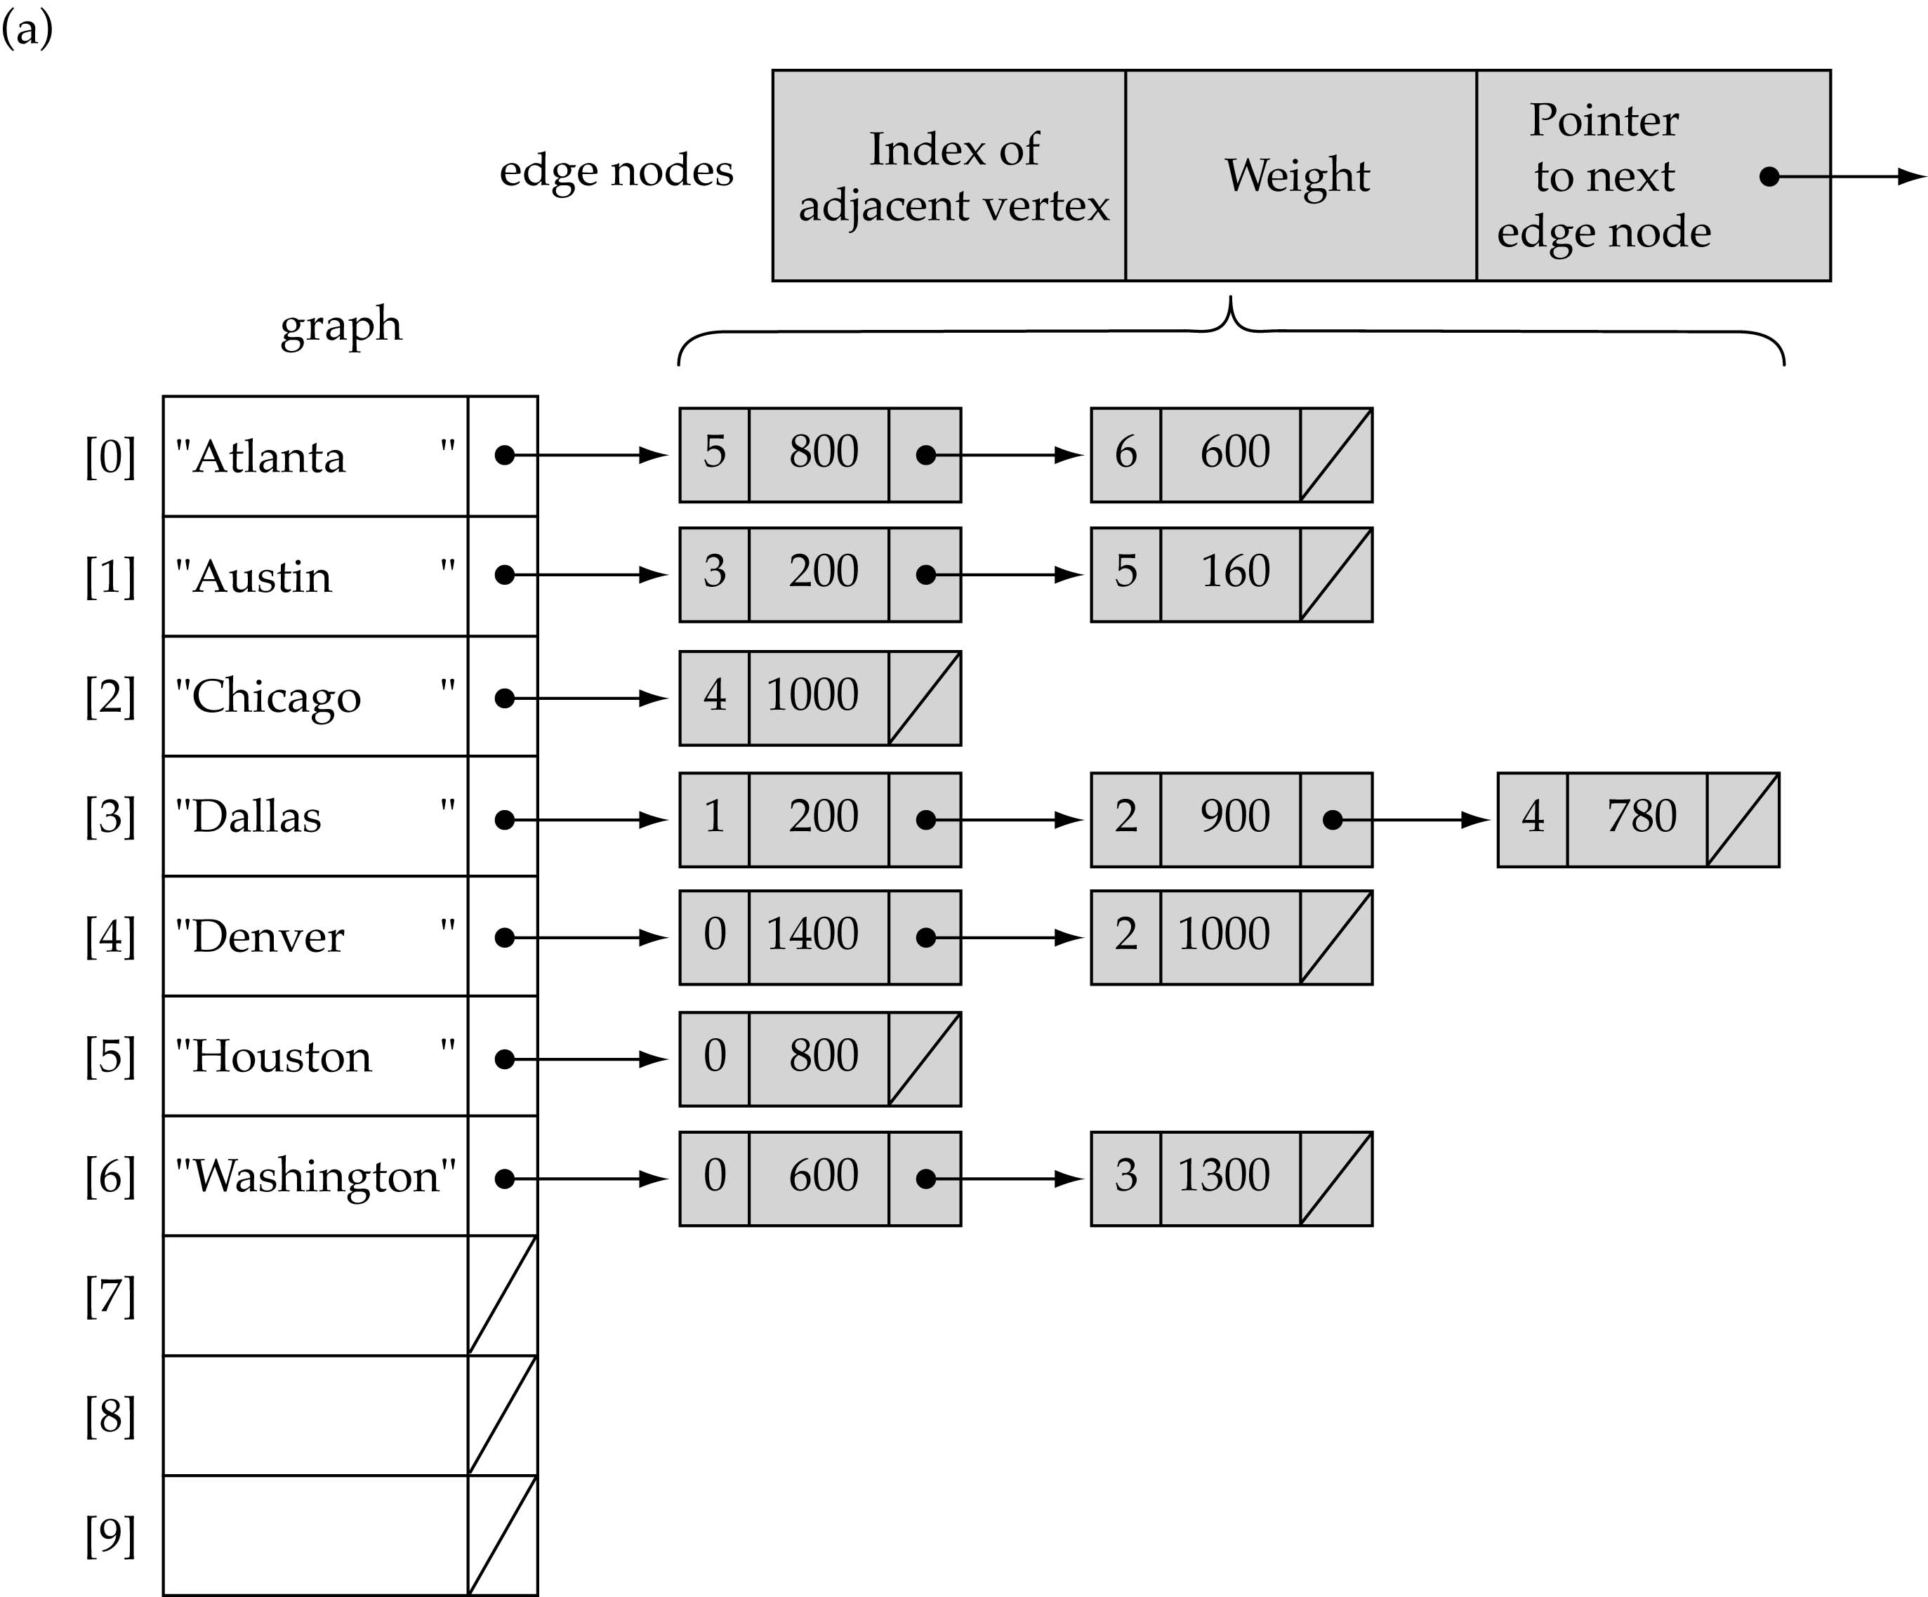
Linked-list implementation

Slide 24
Graph Traversal
Traversal is the facility to move through a structure visiting each of the vertices once.
We looked previously at the ways in which a binary tree can be traversed. Two of the traversal methods for a graph are breadth-first and depth-first.

Slide 25
Breadth-First Graph Traversal
This method visits all the vertices, beginning with a specified start vertex. It can be described roughly as “neighbours-first”.
No vertex is visited more than once, and vertices are visited only if they can be reached – that is, if there is a path from the start vertex.
Breadth-first traversal makes use of a queue data structure. The queue holds a list of vertices which have not been visited yet but which should be visited soon.
Since a queue is a first-in first-out structure, vertices are visited in the order in which they are added to the queue.
Visiting a vertex involves, for example, outputting the data stored in that vertex, and also adding its neighbours to the queue.
Neighbours are not added to the queue if they are already in the queue, or have already been visited.

Slide 26
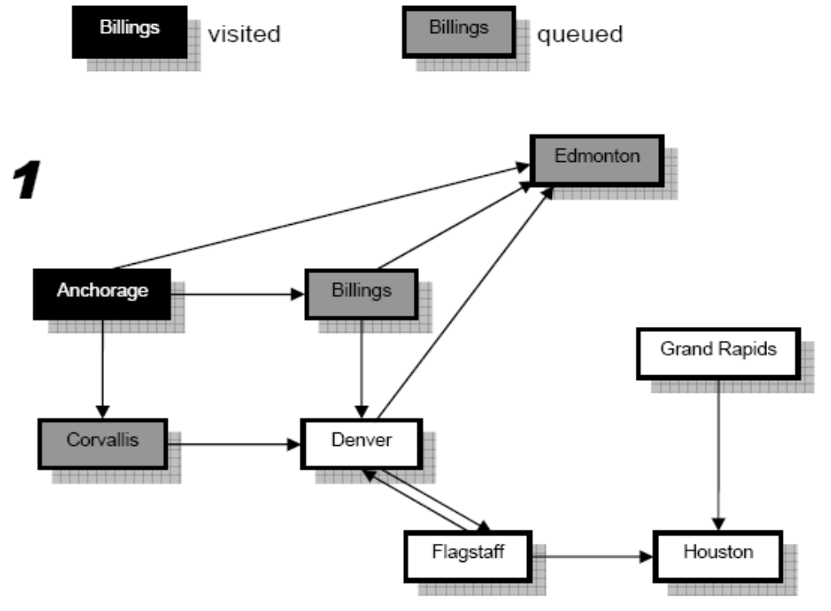
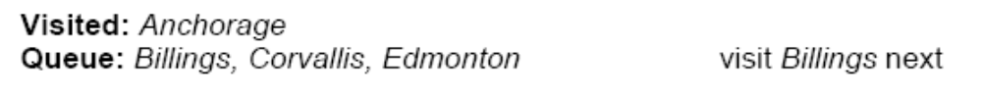
Breadth-First Traversal Example
Neighbours are added to the queue in alphabetical order. Visited and queued vertices are shown as follows:

Slide 27
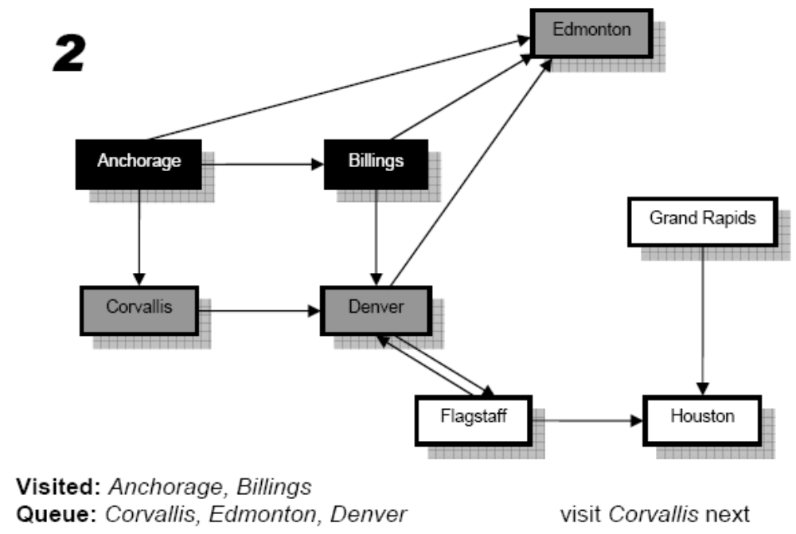
Breadth-First Graph Traversal
Note that we only add Denver to the queue as the other neighbours of Billings are already in the queue.

Slide 28
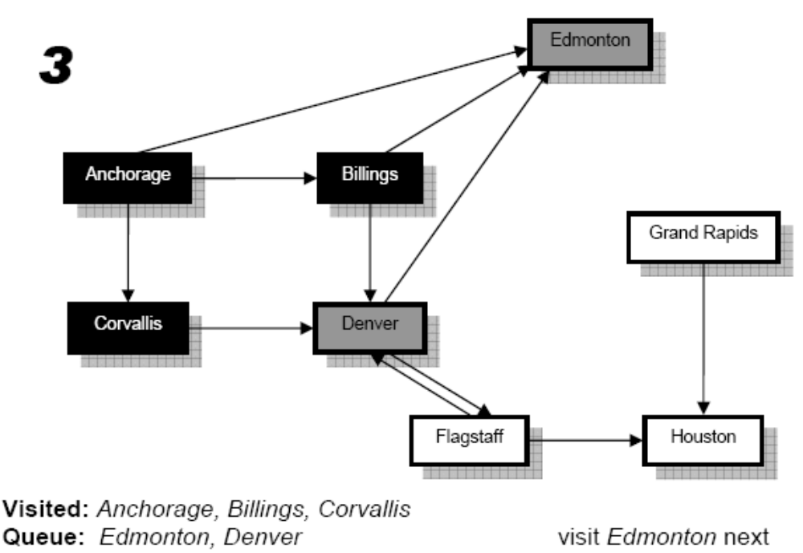
Breadth-First Graph Traversal
Note that nothing is added to the queue as Denver, the only neighbour of Corvallis, is already in the queue.

Slide 29
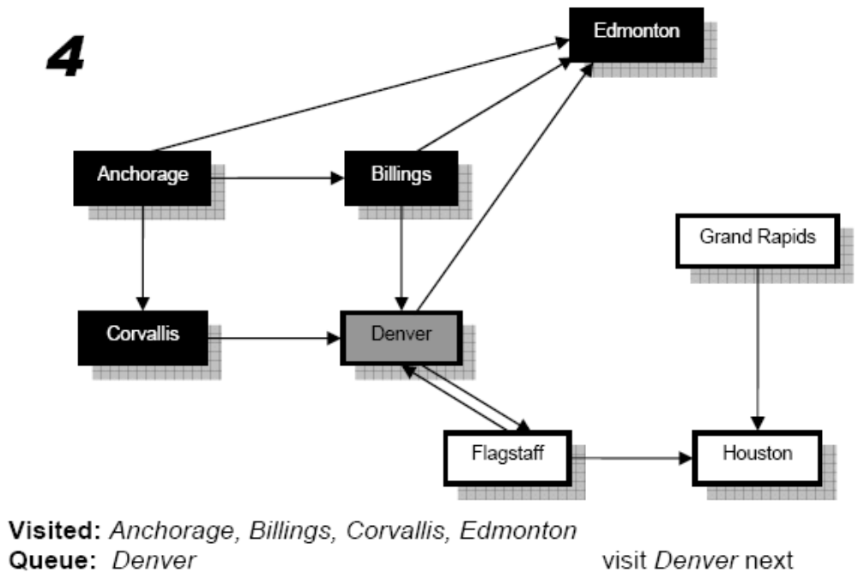
Breadth-First Graph Traversal

Slide 30
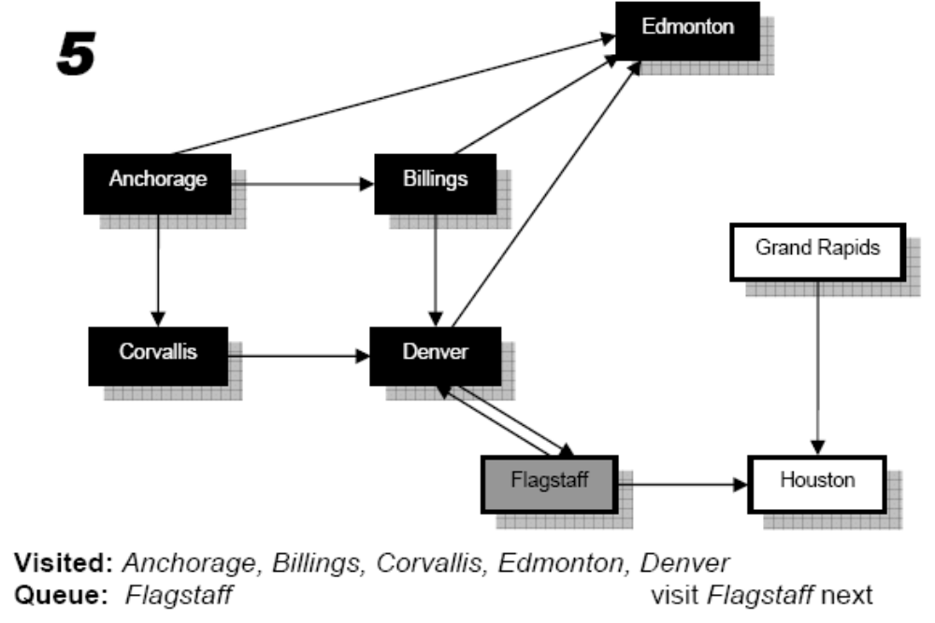
Breadth-First Graph Traversal

Slide 31
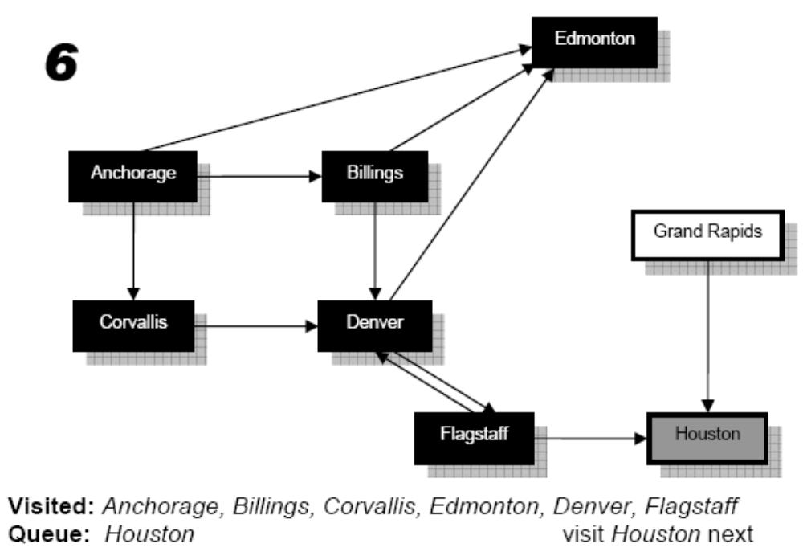
Breadth-First Graph Traversal

Slide 32
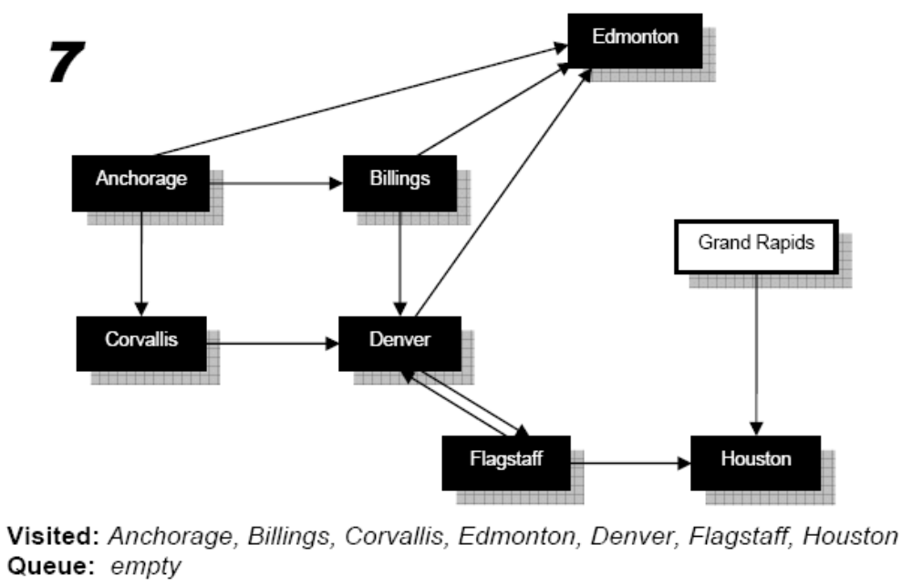
Breadth-First Graph Traversal
Note that Grand Rapids was not added to the queue as there is no path from Houston because of the edge direction.
Since the queue is empty, we must stop, so the traversal is complete.
The order of traversal was:Anchorage, Billings, Corvallis, Edmonton, Denver, Flagstaff, Houston

Slide 33
Exercise
Solve it using BFS
A
C
D
B
E
I
H
F
G

Slide 34
Exercise 2
Solve it using BFS
A
B
H
E
C
D
F
G

Slide 35
Depth-First Search (DFS)

Slide 36
Depth-First Search
From the given vertex, visit one of its adjacent vertices and leave others;
Then visit one of the adjacent vertices of the previous vertex;
Continue the process, visit the graph as deep as possible until:
  A visited vertex is reached;
  An end vertex is reached.

Slide 37
Depth-First Traversal
Depth-first traversal of a graph:
Start the traversal from an arbitrary vertex;
Apply depth-first search;
When the search terminates, backtrack to the previous vertex of the finishing point,
Repeat depth-first search on other adjacent vertices, then backtrack to one level up.
Continue the process until all the vertices that are reachable from the starting vertex are visited.
Repeat above processes until all vertices are visited.

Slide 38
Depth First Search Traversal
This method visits all the vertices, beginning with a specified start vertex.
This strategy proceeds along a path from vertex V as deeply into the graph as possible.
This means that after visiting V, the algorithm tries to visit any unvisited vertex adjacent to V.
When the traversal reaches a vertex which has no adjacent vertex, it back tracks and visits an unvisited adjacent vertex.
Depth-first traversal makes use of a Stack data structure.

Slide 39
DFS Example
A
B
C
D
E
F
A B C F E D

Slide 40
Adjacency List Implementation
class Graph
{
private:
struct GNode{
int data;
GNode *ptr;
};
GNode *GList;
public:
graph();
void Create();
void InsertVertex(int);
void InsertEdge();
void DisplayVertices();
void DeleteVertex();
void DeleteEdges();
bool SearchVertex();
bool SearchEdge();
void BFSTraversal();
void DFSTraversal();
};

Slide 41
create( )
void Graph::Create()
{
GList = new GNode[10];
for(int i=0; i<10; i++)
{
GList[i].data=-1;
GList[i].ptr=NULL;
}
}

Slide 42
InsertVertex( )
void Graph::InsertVertex ( int VCount )
{
int num;
cout<<"Enter Vertex/Node Number =";
cin>>num;
GList[VCount].data=num;
}

Slide 43
InsertEdge( )
void Graph::InsertEdge()
{ int i, source,dest;
cout<<"Enter Source Node=";
cin>>source;
cout<<"Enter Destinition Node=";
cin>>dest;
for(i=0;i<10;i++)
if(source==GList[i].data)
break;
GNode *check,*temp =new GNode;
temp->data=dest;
temp->ptr=NULL;
check = GList[i].ptr;

Slide 44
if(check!=NULL)
{
while(check->ptr!=NULL)
{
check=check->ptr;
}
check->ptr=temp;
}
else
GList[i].ptr=temp;
getche();
}

Slide 45
SearchVertex( )
bool Graph::SearchVertex()
{
int vertex;
cout<<"Enter Vertex To Be Searched=";
cin>>vertex;
for(int i=0;i<10;i++)
if(GList[i].data ==vertex)
return true;
return false;
}

Slide 46
SearchEdge( )
bool Graph::SearchEdge()
{
int source, dest;
GNode *temp;
cout<<"Enter Edge to be searched"<<endl;
cout<<"Enter Source Vertex=";
cin>>source;
cout<<"Enter Destination Vertex=";
cin>>dest;

Slide 47
for( int i=0;i<10;i++)
{
if(source==GList[i].data)
{
temp=GList[i].ptr;
while(temp!=NULL)
{
if(temp->data==dest)
return true;
else
temp=temp->ptr;
}
}
}
return false;
}

